Slide 1
OpenShift 4.x Architecture Workshop
Istio Service Mesh
July 2019

Slide 2
Microservices
Benefits and Challenges

Slide 3

MICROSERVICES ARCHITECTURE
DISTRIBUTED
Service
Service
Service
HTML
Javascript
Web
Runtime
Runtime
Runtime
Service
Service
Service
Service
Service
Service
Service
Service
Service
Data Access
Runtime
Runtime
Runtime
Application Server
Service
Service
Service
Runtime
Runtime
Runtime
Notes:
A lot has been written about the benefits of microservices over the past several years. Essentially microservices is an architectural style that focuses on creating applications from many smaller services as opposed to building apps as a single monolithic unit. The smaller services are often independently deployable and maintainable. They typically communicate over HTTP.
There’s lots of benefits to this approach, for instance you can create applications that can scale at a more granular level. For instance, if only a piece of your application needs to scale, then you can scale a service as opposed to scaling the entire monolithic application. If you’re doing things correctly, you can make your applications more extensible and increase your availability by avoiding single points of failure.
When you break the monolith to smaller services, you tend to get a lot of them (what used to be libraries/functions are now services) and as the number increases the complexity of communications between these services increases as well. What used to be a function call from one piece of code to another in the monolith, is now an API call over the network which means we are relying a lot more on the network characteristics than we use to. When you adopt a microservices architecture you inherently doing distributed computing.

Slide 4
DISTRIBUTED COMPUTING CHALLENGES
Fallacies of Distributed Computing
The network is reliable.
Latency is zero.
Bandwidth is infinite.
The network is secure.
Topology doesn't change.
There is one administrator.
Transport cost is zero.
The network is homogeneous.
wikipedia.org/wiki/Fallacies_of_distributed_computing
Notes:
Now that you’re relying more on the network there’s a lot of new things that you need to consider to create robust applications. If you’ve been following microservices thought leadership for a while, you’ve probably seen this list somewhere. It’s essentially a list of consideration you can’t avoid when you adopt microservices. I won’t cover all of them, but I’d like to point out three specific ones that customers often have to graple with:
First, the network is reliable, in a traditional monolithic application you make a lot of assumptions that pieces of your application are reliable. It’s a fair assumption since your app is all running together and is usually loading libraries and functions from memory. However, when you move into the microservices model, you can no longer make this assumption. For instance, how is your application going to behave when the network is done? Is your application going to wait and retry for dependencies to become available or is it going to crash and need to be restarted in a specific order when the network is backup?
The network is secure. When you use libraries in a monolithic application this isn’t as big of a concern, but when you communicate over a network there’s a big attack vector. You need to make sure that your communication is encrypted and you trust who you are communicating with.
The topology doesn’t change. Imagine for a second that your services relies on an AWS EC2 instance. If you’re not using Elastic IPs (which cost extra), the external IP address for that VM instance is going to change if the machine is restarted. Will your service still work properly when this happens to one of his upstream dependncies?

Slide 5
DISTRIBUTED ARCHITECTURE
Service
Service
Service
Service
Service
Service
Service
Service
Service
Notes:
As you can probably imagine now, in this model, if you add new services that's going to mean more complexity and potential hazards that can happen.

Slide 6
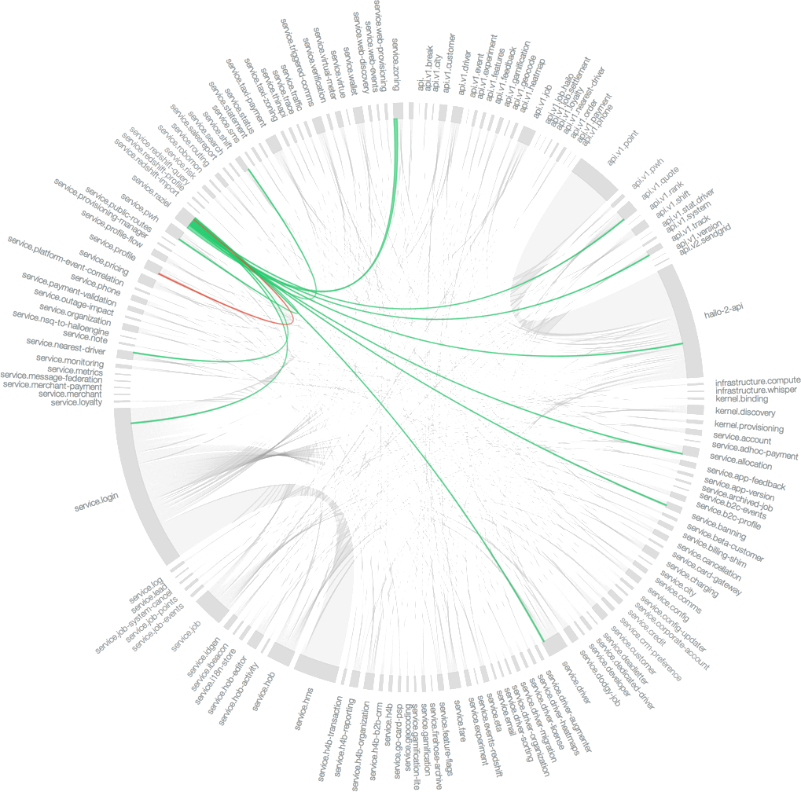
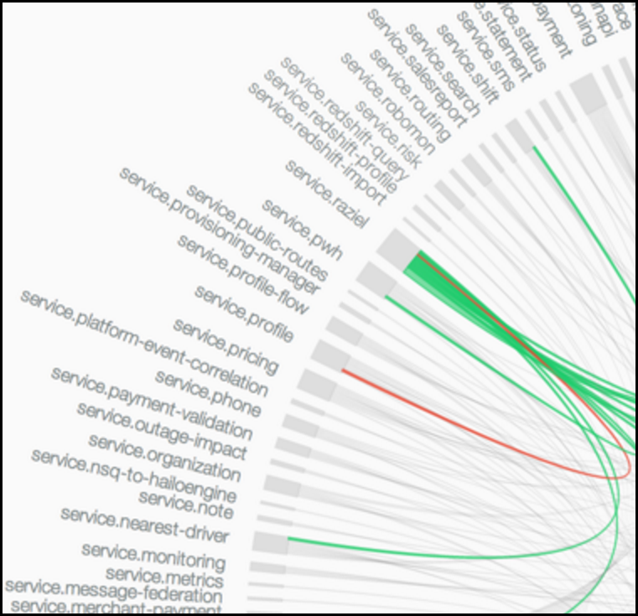
MICROSERVICES ARE HARD
B
C
D
H
Client
A
Because applications must deal with
Unpredictable failures
End-to-end application correctness
System degradation
Topology changes
Elastic/ephemeral/transient resources
Distributed logs
The fallacies of distributed computing
F
G
E
I
Notes:
What this all means for you is that a move to microservices can be hard. There's some new capabilities that you now need to add to your services that are not necessarily business capabilities. A lot of these new capabilities are going to revolve around handling failures. You are going to have IP addresses that change. You are going to have dependencies that are unavailable. You are going to have slow response times for a dependency. Yet through all that, you're going to need to be able to handle end to end application correctness. Users want capabilities that are running and behaving as expected. So you need to design your applications in such a way that the microservices still work if there's a network timeout, or have some so sort of fallback capability when a critical dependency is unavailable.

Slide 7




AN EXAMPLE
ACME Laptop 128GB SSD, 8GB RAM
$323.56
Pricing Engine
Reviews
Touchscreen
128GB SSD 8GB RAM
Core i3
Windows 10
Details/Specifications
Add to Cart
In-Store Pickup (15 available) Raleigh, Central Ave, Store #1123
Location-based availability
Recommendations
People who purchased also...
Notes:
Now let’s use a specific real world example to point out the challenge. When you open up an application on your mobile device, although it appears as a monolithic application, it’s likely going to call many backend services that are running on a server somewhere to operate at full capacity. For instance, if you open up a ecommerce application such as Amazon you may look at an item and it may have a wide variety of capabilities that are being created from many backend services. For instance, a pricing service may be giving you the price of the item in your cart, in this case a new laptop. There may be more services for review ratings, or location-based availability, or one for a recommendation service.
But these

Slide 8

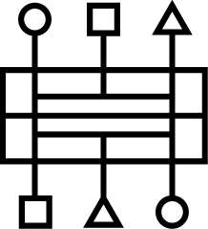



CHAINING
Notes:
Each of these services may have other services they rely upon. For instance at Amazon, they actually have services that go out and scrap against Walmart, Target, etc and check prices to make sure that they’re offering up the lowest price. These service dependencies may have common items like a database, a cache, or an HTTP rest service.

Slide 9
CHAINING (FAILURE)
X
Notes:
Now think about what might happen if the downstream service is scraping against target.com and they change their website and the service completely crashes. You now have a critical piece of functionality that is broken.

Slide 10
CHAINING (CASCADING FAILURE)
X
X
X
X
X
Notes:
Is there now going to be a cascading failure that breaks the entire pricing engine? Is the application now going to stop working because the pricing engine is now broken? Solving these problems are not trivial. Especially since you won’t your code to focus on business capabilities, things that provide business value. You don’t want to spend all your time figuring out how to handle failures.

Slide 11
Traditional Approaches

Slide 12
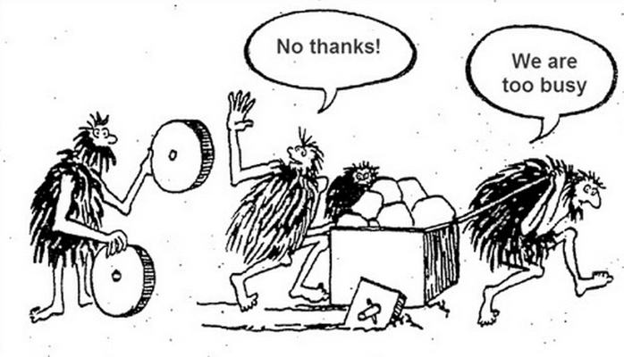
POSSIBLE SOLUTIONS
Have your developers do this:
Circuit Breaking
Bulkheading
Timeouts/Retries
Service Discovery
Load Balancing
Traffic Control
Notes:
One common way to help prevent cascading failures is to have a configurable number of timeouts and retries that the service will try before it considers the service as failed. The service then will also have what’s called a circuit breaker from further exacerbate the problem. The basic idea behind the circuit breaker is very simple. You wrap a protected function call in a circuit breaker object, which monitors for failures. Once the failures reach a certain threshold, the circuit breaker trips, and all further calls to the circuit breaker return with an error, without the protected call being made at all. You may even set specific thresholds to trip the circuit breaker such as a 25% failure rate.
Cascading failures is just one common thing that developers will need to tackle, but there are more as well.

Slide 13

Container
Hystrix
JVM
service A
Zuul
discovery
Ribbon
load-balancer
resiliency
Eureka
metrics
tracing
Archaius
app logic
Need a library to support each language/framework combination
Notes:
Entire suites of frameworks were built to help developers address these resilience concerns.
Some of the big web companies had to put frameworks and libraries into place to help alleviate some of the challenges of an reliable network and many code deployments per day. For example, companies like Netflix created projects like Netflix OSS Ribbon, Hystrix, and Eureka to solve these types of problems. Others such as Twitter and Google ended up doing similar things. These frameworks that they created were very language and platform specific and, in some cases, made it very difficult to bring in new microservices written in programming languages that didn’t have support from these resilience frameworks they created. Whenever these resilience frameworks were updated, the applications also needed to be updated to stay in lock step.
Service discovery (e.g. with Eureka)
Client-side load balancing (e.g. with Netfix Ribbon)
Circuit breaking and Bulkheading (e.g. with Netfix Hystrix)
The downside is that you need a library to support each combination of the language and framework you are supporting. The Netflix OSS largely supports Java. There’s specific libraries that you now need to add your application. So imagine building and maintaining this at scale. Especially if you move to containers. If you have a Java application each application will now have a JVM, a library for each Netflix OSS component, the application itself in addition to potentially also having agents for logging and/or metrics. You’re now building containers that are very large and hard to maintain.

Slide 14


WHAT ABOUT…?
POLYGLOT
APPS
EXISTING
APPS
Notes:
Services are made responsible to address the complexity of distributed architectures
What about existing apps?
You have rewire them to be able to support these capabilities?
What about other languages?
You have to find other frameworks that might provide similar functionality
Or you might have to implement yourself
Ending up with a variety of frameworks and libraries that solve these complexities in different ways

Slide 15
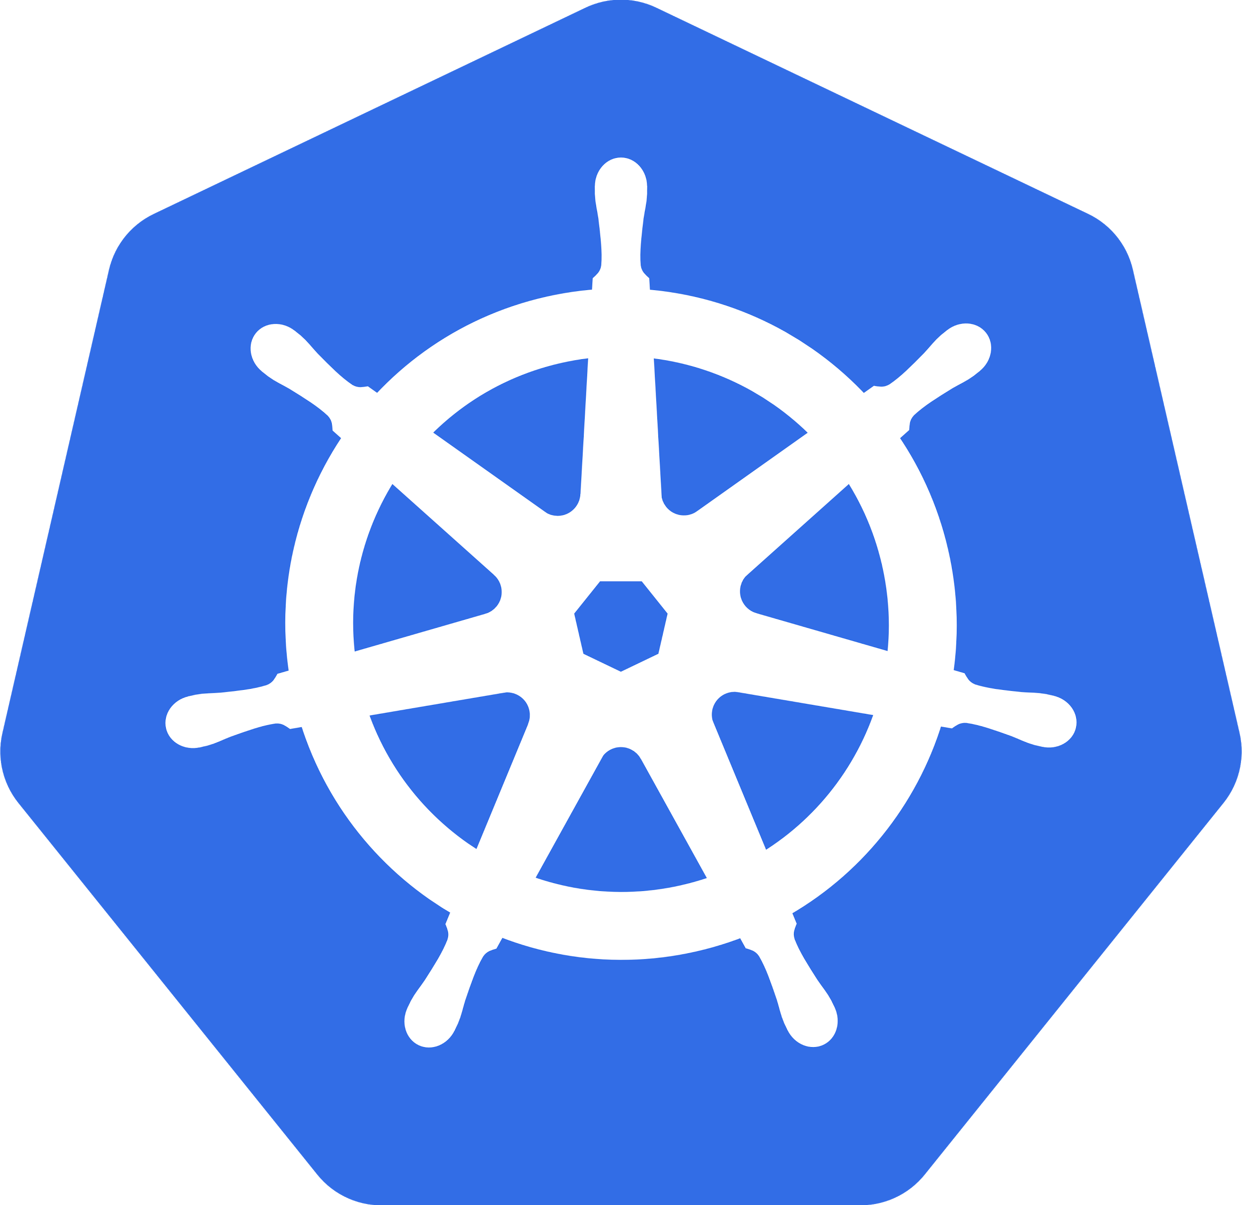

Kubernetes exacerbates the problem
The trends of containerization, microservices and hybrid/multi-cloud deployments have created more distributed applications than ever.
This has left enterprises unable to connect, observe or secure or control their services in a consistent way.
Notes:
Traditional monolithic applications can definitely be successful but people often frustrated when tyring to move them into a cloud because everything is so coupled together. A small change requires everything to be rebuilt and deployed. As IT organizations adopt microservices, keeping track of everything is already a challenge. For most people, modern microservices and containers go hand in hand. So when you run containers on premise or in the cloud, for most people that means orchestrating them with Kubernetes which is the de-facto standard to orchestrate containers. Yet, using Kubernetes for microservices actually exacerbates the old problems because people are now creating more containers and microservices than ever before. This has left enterprises unable to connect, observe secure, and control their microservices in any consistent way. I chose those words those carefully because as you’ll see with istio that a lot of the capabilities specifically fall into those categories: connect, observe, secure, control.

Slide 16
Enter the service mesh

Slide 17

SERVICE MESH
A dedicated network for service-to-service communications
Photo on Visual Hunt
Notes:
The service mesh is designed as a better way to implement all of these microservices capabilities. Instead of piling on libraries into an application, a service mesh is a dedicated network for these communications. The goal is to completely separate your application and its business value from the infrastructure.

Slide 18
A better way with a service mesh
A service mesh provides a transparent and language-independent network for connecting, observing, securing and controlling the connectivity between services.
Service
Tracing
Circuit Breaker
Routing
Service
Svc Discovery
Config
Platform
Container Platform (+ Service Mesh)
...2014
2018
Notes:
The service mesh makes the platform responsible for providing those services to any application (existing or new, in any programming language or framework) that is running on the platform. The services then can really be micro and focus on their business logic rather than cloud-native complexities. This way you now can support not only Java based microservices, but monolithic applications and services written in any language, making it language agnostic. By doing so your developer will not have to hard code operational dependencies. It promotes separation of concerns. Developers focus can focus on value.

Slide 19
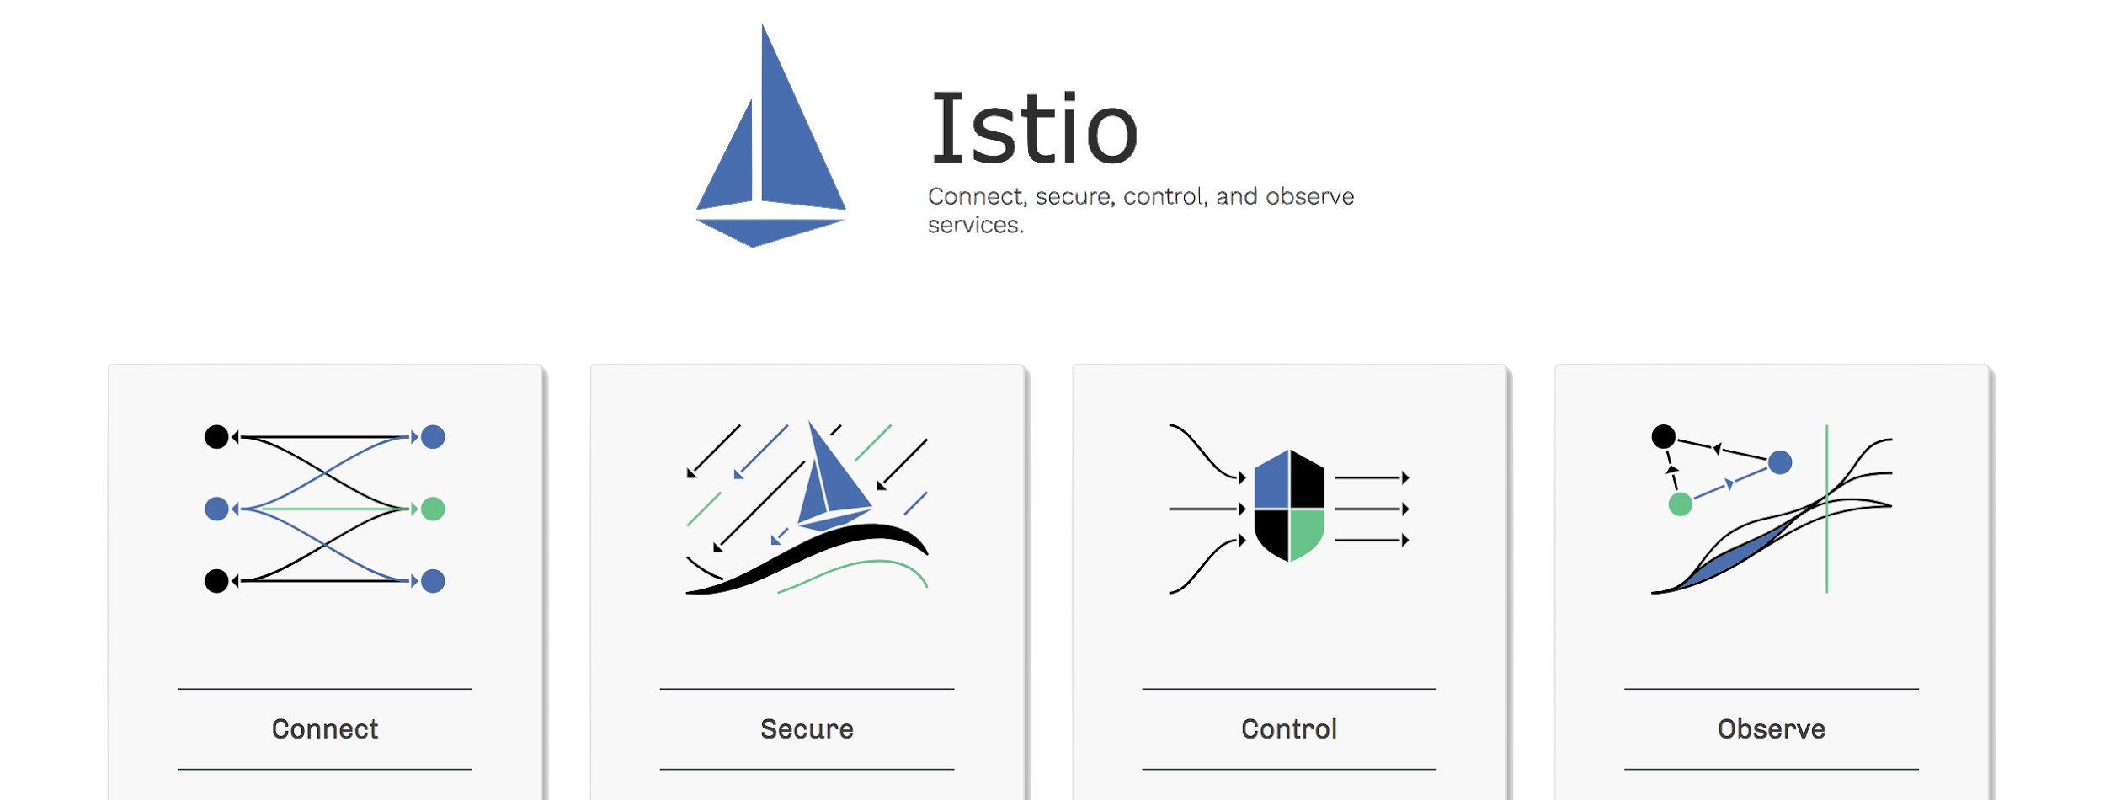
Notes:
The term service mesh is used to describe the network of microservices that make up such applications and the interactions between them. As a microservices system grows in size and complexity, it can become harder to understand and manage.
Istio has the goal to reduce the complexity of services deployments and to ease the strain on your development teams - within the scope of connect, secure, control, and observe

Slide 20
ISTIO’S CAPABILITIES AT 10,000 FEET
Traffic Management.
Rules and traffic routing lets you control the flow of traffic and API calls between services.
Service Identity and Security.
Enforce consistently across diverse protocols and runtimes with little or no application changes.
Policy Enforcement.
Apply to the interaction between services and ensure they are enforced. Changes are made by configuring the mesh, not by changing application code.
Observability.
Gain understanding of the dependencies between services and the nature and flow of traffic between them, providing the ability to quickly identify and fix issues.
Notes:
So at 10,000 ft istio enables:
- Traffic mgmt by providing you the ability to configure rules to routing traffic between services - catch issues before they cause problems, make calls more reliable, and your network more robust
- Service identity and security of the underlying secure communication channel, so developers can focus on the applications and app level security
- Policy enforcement that is configurable so that you can increase service uptime and reduce the chance unexpected events break the system
- Observability logging so that you can detect and fix issues quickly
https://istio.io/docs/concepts/traffic-management/
https://istio.io/docs/concepts/security/
https://istio.io/docs/concepts/policies-and-telemetry/
https://istio.io/docs/tasks/telemetry/

Slide 21
MICROSERVICES WITH ISTIO
connect, manage, and secure microservices transparently
Pod
Sidecar Container
Pod
Istio Logic
Pod
Sidecar Container
Sidecar Container
Microservice Container
Istio Logic
Istio Logic
App/Service B
Microservice Container
Microservice Container
App/Service A
App/Service C

Slide 22
WHAT IS A SIDECAR?
A proxy instance that abstracts common logic away from individual services
SIDECAR PATTERN
A utility container in the same pod to enhance the main container’s functionality
Share the same network and lifecycle
Istio uses an Istio Proxy (L7 Proxy) sidecar to proxy all network traffic between apps
POD
SIDECAR
APP

Slide 23


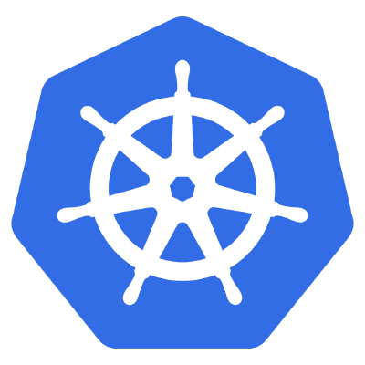
ISTIO PROVIDES BOTH CONTROL AND DATA PLANES
Data
Plane
The data plane is composed of a set of intelligent proxies (Envoy) deployed as sidecars that mediate and control all network communication between microservices.
The control plane is responsible for managing and configuring proxies to route traffic, as well as enforcing policies at runtime.
Pod
Pod
Pod
Pod
App
App
App
App
Envoy
Envoy
Envoy
Envoy
Control
Plane

Slide 24

COMPONENTS OF ISTIO
Envoy, originally from Lyft - it’s an intelligent proxy. Highly parallel non-blocking, network filtering, service discovery, health checking, dynamically configurable.
Pilot, the component responsible for managing a distributed deployment of Envoy proxies in the service mesh. Intelligent routing, traffic mgmt, resiliency
Mixer, which provides the policy and access control mechanisms within the service mesh. Monitoring, reporting, quotas - plugin-based.
Citadel, control service-service traffic based on origin and user. Key mgmt certificate authority.
Data
Plane
It’s the sidecar
Pod
Pod
Pod
Pod
Envoy
Envoy
Envoy
Envoy
App
App
App
App
Control
Plane
Pilot
Mixer
Citadel

Slide 25
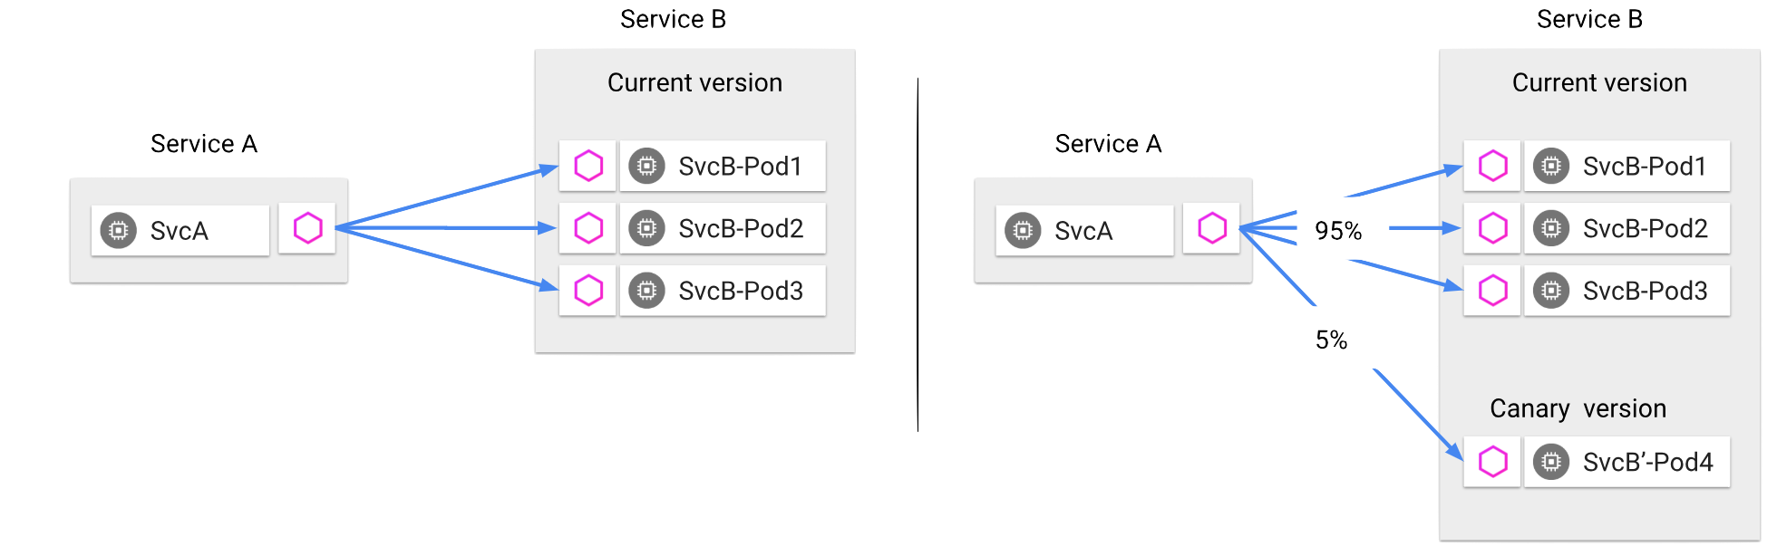
WHAT DOES CONNECT MEAN?
Version = 1.2.3
Version = 1.2.4
Discovery and Routing: Decoupled from infrastructure, load balancing modes, dynamic routing...
Advanced Deployments: A/B testing, gradual rollouts, canary releases, mirroring...
Failure, Health, and Testing: timeouts, retries, circuit breakers, fault injection, active health checks...
Notes:
decouples traffic flow and infrastructure scaling, you can specify what rules you want traffic to follow rather than which specific pods/VMs should receive traffic
Note: The service mesh is not an overlay network. It simplifies and enhances how microservices in an application talk to each other over the network provided by the underlying platform

Slide 26
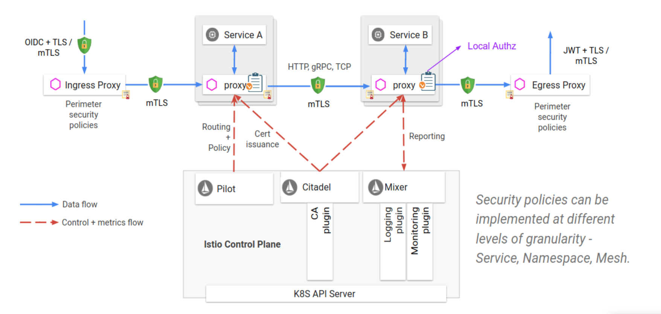
HOW DO YOU SECURE SERVICES?
Security by default no changes needed for application code and infrastructure | Defense in depth integrate with existing security systems to provide multiple layers of defense | Zero-trust network build security solutions on untrusted networks
Notes:
Istio manages authentication, authorization, and encryption of service communication at scale
Talk through an example: Adding encryption to a system that didn’t have it before…

Slide 27
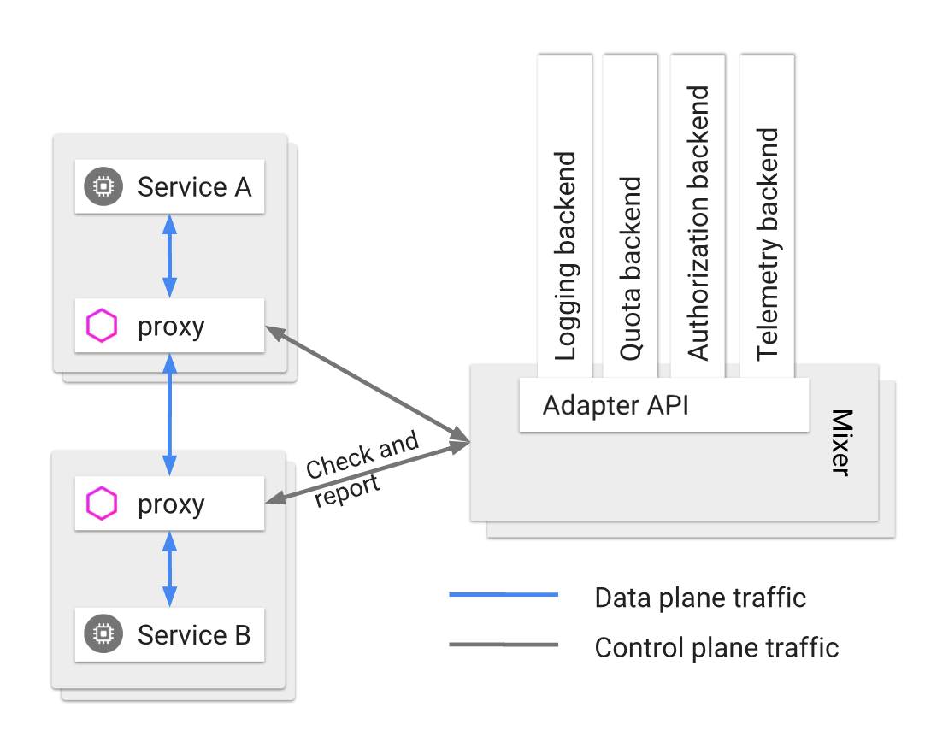
WHAT CAN YOU CONTROL?
Restrict to 2 requests per second per IP :
quotas:
- name: requestcount.quota.istio-system
overrides:
- dimensions:
destination: someservice
maxAmount: 2
Exempt if:
match(request.headers["cookie"], "user=*") == false
Set and Check Policy: Open-ended, connection limits, rate limits, simple denials, lists
Notes:
Attach 3rd party adapters and collect metrics then configure and let let istio ensure that the services adhere to those policies

Slide 28
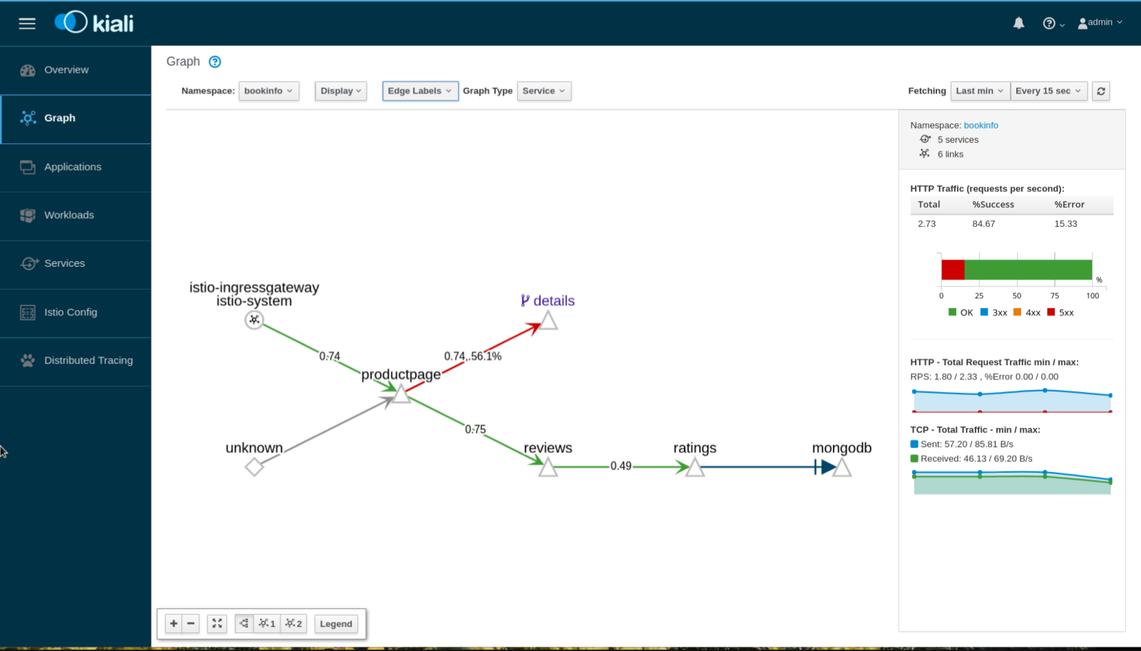
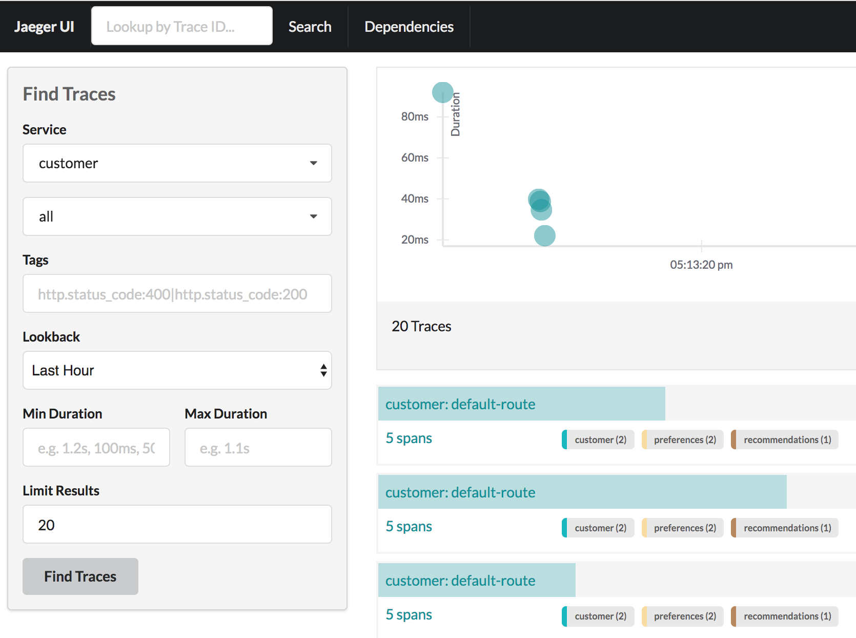
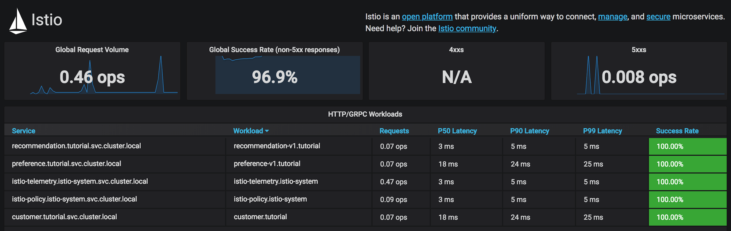
HOW CAN YOU OBSERVE?
Understand how your services are operating: Metrics, tracing, network visibility

Slide 29
ISTIO AVAILABILITY
Istio 1.0!
After over a year of work,
~200 developers
Google, IBM, VMWare, Cisco, Red Hat, others...
Adaptors for many monitoring systems
Istio on OpenShift
Available in Dev Preview today (3.10)
GA coming soon (4.1)

Slide 30
ISTIO ON OPENSHIFT
Istio on OpenShift
Available in Dev Preview today (3.10)
GA coming soon (4.1)
Istio is an “operator first product” (using Operator Framework)
https://github.com/Maistra/istio-operator
The operator manages the install (eventually updates)
Istio is delivered as containers, not RPMs

Slide 31

TRY IT YOURSELF
https://learn.openshift.com/servicemesh/

